Slide 1
The chief merit of language is clearness.
  Galen
Our life is frittered away by detail…. Simplify, simplify.
  Henry David Thoreau
He had a wonderful talent for packing thought close, and rendering it portable.
  Thomas B. Macaulay
Man is still the most extraordinary computer of all.
  John F. Kennedy

Slide 2
OBJECTIVES
In this chapter you will learn:
Basic object-technology concepts, such as classes, objects, attributes, behaviors, encapsulation and inheritance.
The different types of programming languages.
Which programming languages are most widely used.
A typical C++ program development environment.
The history of the industry-standard object-oriented system modeling language, the UML.
The history of the Internet and the World Wide Web.
To test-drive C++ applications in two popular C++ environments—GNU C++ running on Linux and Microsoft's Visual C++® .NET running on Windows® XP.

Slide 3
1.8 History of C and C++
1.9 C++ Standard Library
1.10 History of Java
1.11 FORTRAN, COBOL, Pascal and Ada
1.12 Basic, Visual Basic, Visual C++, C# and .NET
1.13 Key Software Trend: Object Technology
1.14 Typical C++ Development Environment
1.15 Notes About C++ and C++ How to Program, 5/e
1.16 Test-Driving a C++ Application
1.17 Software Engineering Case Study: Introduction to Object Technology and the UML (Required)
1.18 Wrap-Up
1.19 Web Resources

Slide 4
1.7 Machine Languages, Assembly Languages and High-Level Languages
Three types of computer languages
  Machine language
    Only language computer directly understands
      “Natural language” of computer
      Defined by hardware design
    Generally consist of strings of numbers
      Ultimately 0s and 1s
    Instruct computers to perform elementary operations
    Cumbersome for humans
    Example
      +1300042774
      +1400593419
      +1200274027

Slide 5
1.7 Machine Languages, Assembly Languages and High-Level Languages (Cont.)
Three types of computer languages (Cont.)
  Assembly language
    English-like abbreviations representing elementary computer operations
    Clearer to humans
    Incomprehensible to computers
      Convert to machine language by translator programs (assemblers)
    Example
      load basepay
      add overpay
      store grosspay

Slide 6
1.7 Machine Languages, Assembly Languages and High-Level Languages (Cont.)
Three types of computer languages (Cont.)
  High-level languages
    Similar to everyday English
      Uses common mathematical notations
    Single statements accomplish substantial tasks
    Converted to machine language by translator programs (compilers)
    Interpreter programs
      Directly execute high-level language programs
      Execute more slowly than the compiled program
    Example
      grossPay = basePay + overTimePay

Slide 7
1.8 History of C and C++
History of C
  Evolved from BCPL and B
    Developed by Dennis Ritchie (Bell Laboratories)
  Development language of UNIX
  Hardware independent
    Can write portable programs
  ANSI and ISO standard for C published in 1990
    ANSI/ISO 9899: 1990

Slide 8
Portability Tip 1.1
Because C is a standardized, hardware-independent, widely available language, applications written in C often can be run with little or no modification on a wide range of computer systems.

Slide 9
1.8 History of C and C++ (Cont.)
History of C++
  Extension of C
    Developed by Bjarne Stroustrup (Bell Laboratories) in early 1980s
  Provides new features to “spruce up” C
  Provides capabilities for object-oriented programming
    Objects: reusable software components
      Model items in the real world
    Object-oriented programs
      Easier to understand, correct and modify

Slide 10
1.9 C++ Standard Library
C++ programs
  Built from pieces called classes and functions
C++ Standard Library
  Rich collections of existing classes and functions
    Reusable in new applications

Slide 11
Software Engineering Observation 1.1
Use a “building-block” approach to create programs. Avoid reinventing the wheel. Use existing pieces wherever possible. Called software reuse, this practice is central to object-oriented programming.

Slide 12
Software Engineering Observation 1.2
When programming in C++, you typically will use the following building blocks: Classes and functions from the C++ Standard Library, classes and functions you and your colleagues create and classes and functions from various popular third-party libraries.

Slide 13
1.10 History of Java
Java
  Originally for intelligent consumer-electronic devices
    Designed by Sun Microsystems
  Then used for creating Web pages with dynamic content
  Now also used for:
    Develop large-scale enterprise applications
    Enhance World Wide Web server functionality
    Provide applications for consumer devices (cell phones, etc.)

Slide 14
1.12 Basic, Visual Basic, Visual C++, C# and .NET
BASIC
  Beginner’s All-Purpose Symbolic Instruction Code
  Familiarize novices with programming techniques
.NET platform
  Provides developers with capabilities
Visual Basic .NET
  Based on BASIC
Visual C++
  Based on C++
C#
  Based on C++ and Java

Slide 15
1.13 Key Software Trend: Object Technology
Objects
  Reusable software components that model real world items
  Meaningful software units
    Time objects, paycheck objects, record objects, etc.
    Any noun can be represented as an object
  More understandable, better organized and easier to maintain than procedural programming
  Libraries of reusable software
    MFC (Microsoft Foundation Classes)
    .NET Framework Class Library
    Rogue Wave

Slide 16
1.14 Typical C++ Development Environment
C++ programs normally undergo six phases
  Edit
    Programmer writes program (and stores source code on disk)
  Preprocess
    Perform certain manipulations before compilation
  Compile
    Compiler translates C++ programs into machine languages
  Link
    Link object code with missing functions and data
  Load
    Transfer executable image to memory
  Execute
    Execute the program one instruction at a time

Slide 17
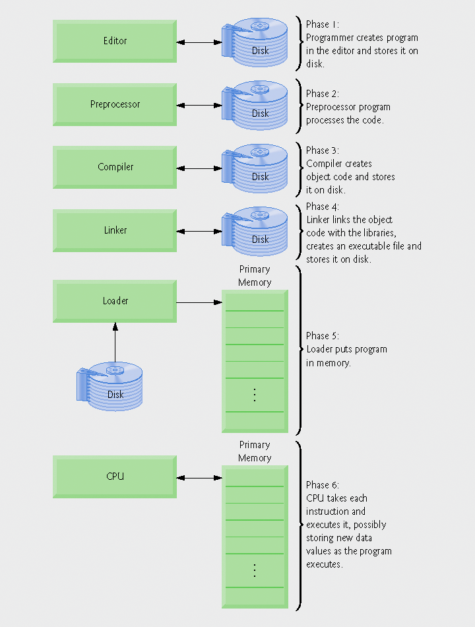
Fig. 1.1 | Typical C++ environment.

Slide 18
1.14 Typical C++ Development Environment (Cont.)
Input/output
  cin
    Standard input stream
    Normally inputs from keyboard
  cout
    Standard output stream
    Normally outputs to computer screen
  cerr
    Standard error stream
    Displays error messages

Slide 19
Portability Tip 1.3
Although it is possible to write portable programs, there are many problems among different C and C++ compilers and different computers that can make portability difficult to achieve. Writing programs in C and C++ does not guarantee portability. The programmer often will need to deal directly with compiler and computer variations. As a group, these are sometimes called platform variations.

Slide 20
Good Programming Practice 1.2
Read the manuals for the version of C++ you are using. Refer to these manuals frequently to be sure you are aware of the rich collection of C++ features and that you are using them correctly.

Slide 21
1.17 Software Engineering Case Study: Introduction to Object Technology and the UML (Required)
Object orientation
  A natural way of thinking about the world and computer programs
Unified Modeling Language (UML)
  Graphical language that uses common notation
  Allows developers to represent object-oriented designs

Slide 22
1.17 Software Engineering Case Study (Cont.)
Objects
  Reusable software components that model real-world items
  Examples are all around you
    People, animals, cars, telephones, microwave ovens, etc.
  Have attributes
    Size, shape, color, weight, etc.
  Exhibit behaviors
    Babies cry, crawl, sleep, etc.; cars accelerate, brake, turn, etc.

Slide 23
1.17 Software Engineering Case Study (Cont.)
Object-oriented design (OOD)
  Models real-world objects in software
  Models communication among objects
  Encapsulates attributes and operations (behaviors)
    Information hiding
    Communication through well-defined interfaces
Object-oriented language
  Programming in object oriented languages is called object-oriented programming (OOP)
  C++ is an object-oriented language
    Programmers can create user-defined types called classes
      Contain data members (attributes) and member functions (behaviors)

Slide 24
Software Engineering Observation 1.4
Reuse of existing classes when building new classes and programs saves time, money and effort. Reuse also helps programmers build more reliable and effective systems, because existing classes and components often have gone through extensive testing, debugging and performance tuning.

Slide 25
1.17 Software Engineering Case Study (Cont.)
Object-Oriented Analysis and Design (OOAD)
  Analyze program requirements, then develop solution
  Essential for large programs
  Plan in pseudocode or UML

Slide 26
1.17 Software Engineering Case Study (Cont.)
History of the UML
  Used to approach OOAD
  Object Management Group (OMG) supervised
    Brainchild of Booch, Rumbaugh and Jacobson
  Version 1.5 is current version
    Version 2 under development
UML
  Graphical representation scheme
  Enables developers to model object-oriented systems
  Flexible and extendible

